Slide 1
Please make a copy!
File -> Make a Copy
Remember to include a text file with each of your SQL queries in your project submission

Slide 2
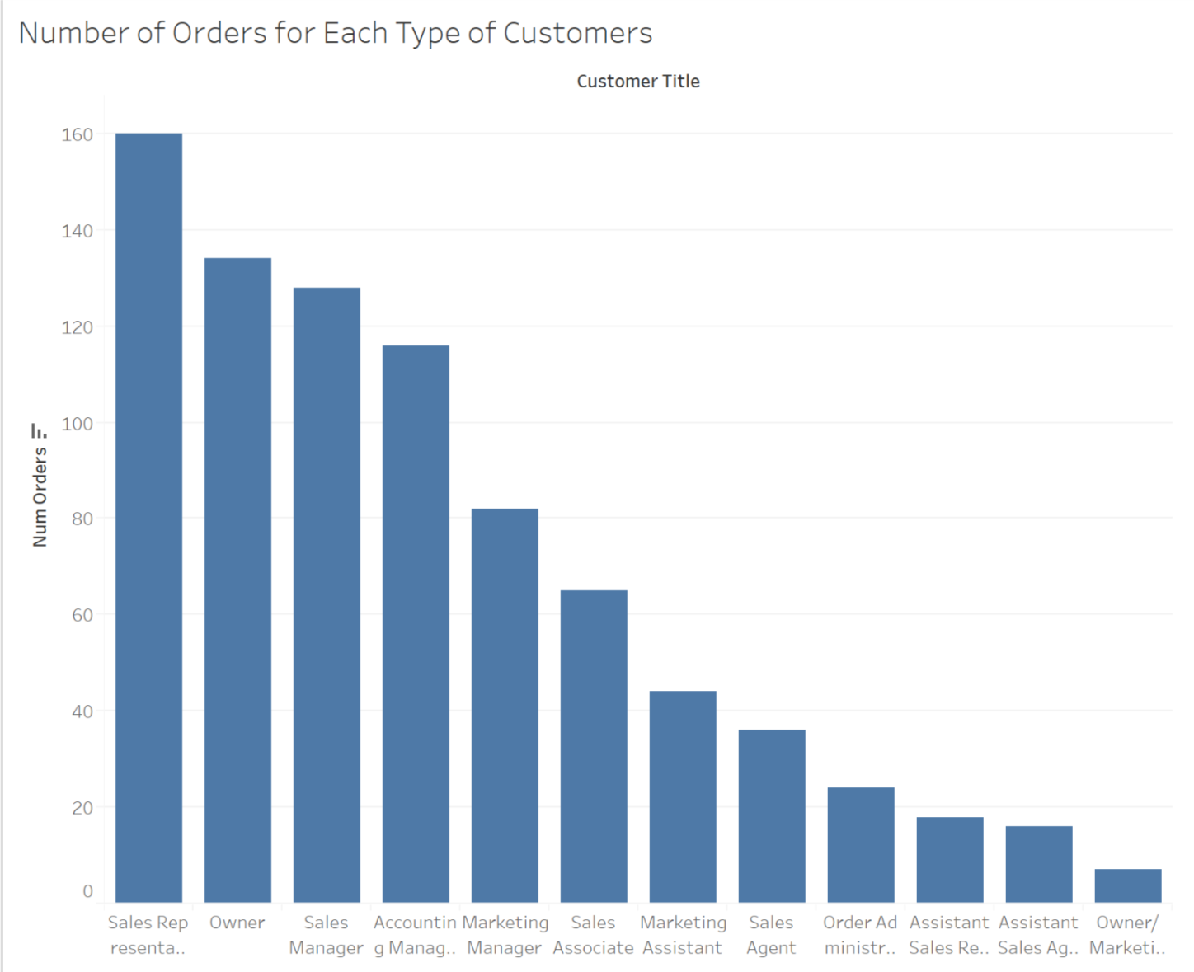
Number of Orders for Each Type of Customers
<visualization>
The total number of orders for each type (represented by customer title) of customers.
This can help the company to allocate time and resource more efficiently based on client company representative type.
Notes:
SELECT c.ContactTitle customer_title, COUNT(*) num_orders
FROM Customers c
JOIN Orders o
ON o.CustomerID = c.CustomerID
GROUP BY 1
ORDER BY 2 DESC;

Slide 3
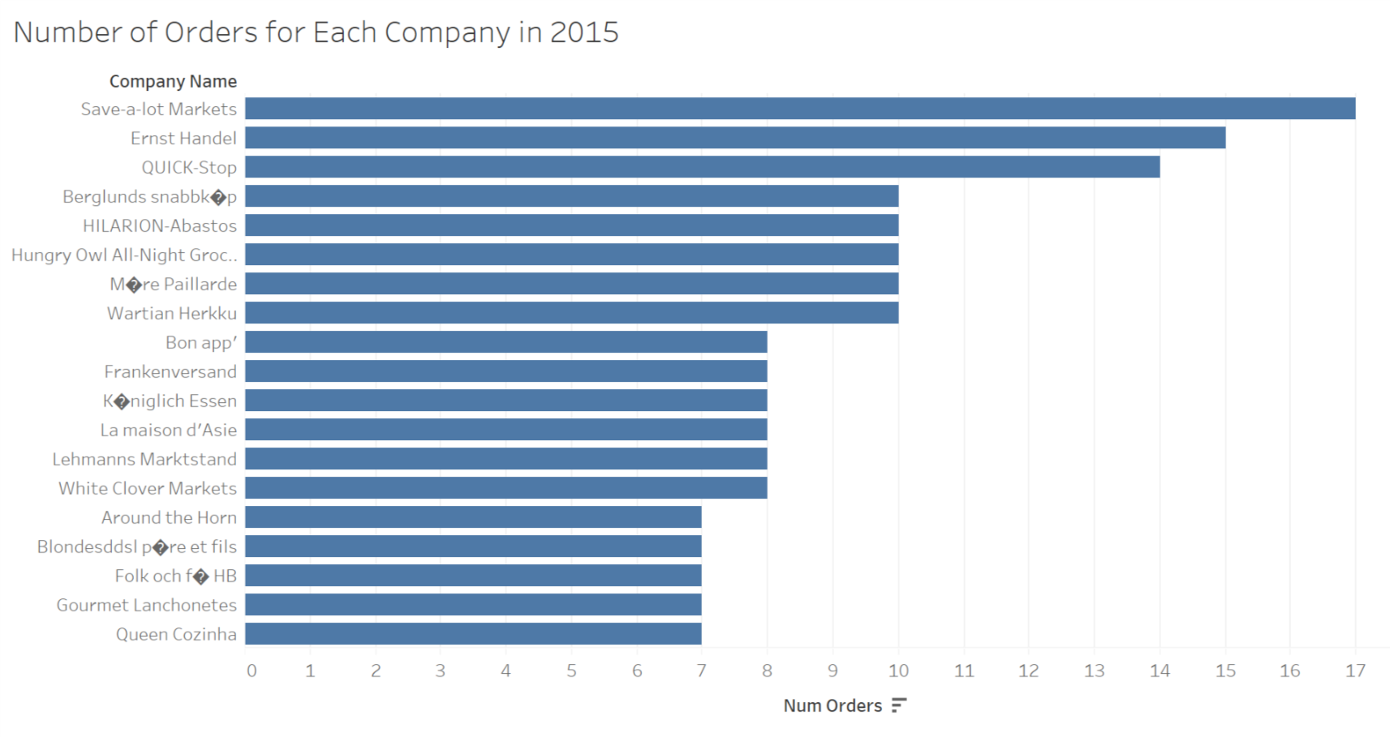
Number of Orders for Each Company in 2015
<visualization>
The top customers ordered by total number of orders in 2015 (only those having > 6 orders are shown).
This indicates the most active companies in the year 2015.
Notes:
SELECT c.CustomerID, c.CompanyName, COUNT(*) num_orders
FROM Customers c
JOIN Orders o
ON o.CustomerID = c.CustomerID
WHERE o.OrderDate BETWEEN '2015-01-01' AND '2015-12-31'
GROUP BY 1, 2
HAVING COUNT(*) > 6
ORDER BY 3 DESC;

Slide 4
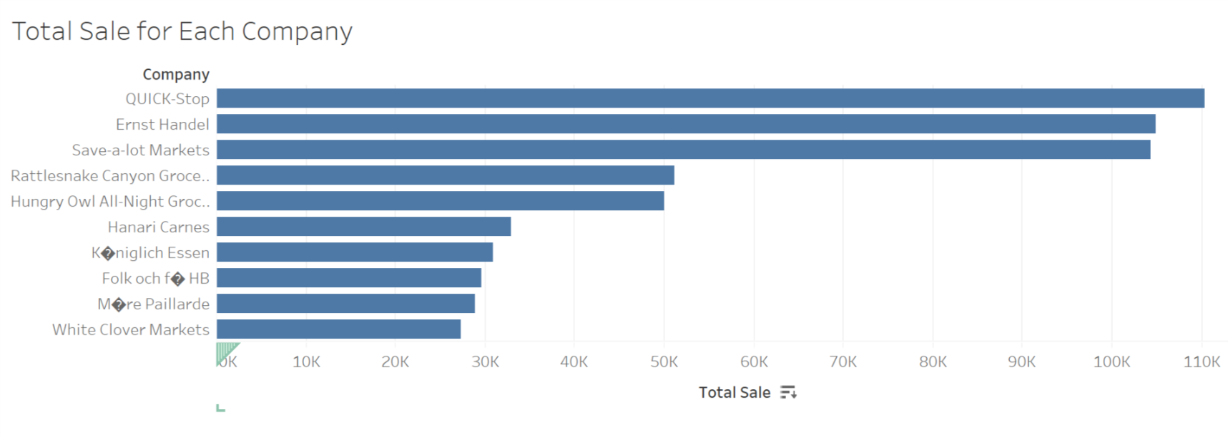
Total Sale for Each Company
<visualization>
The top 10 customers with largest total sales in all years.
This can help the company to focus on those making the largest sales.
Notes:
WITH t1 as (
SELECT o.OrderId, d.UnitPrice*d.Quantity*(1-d.Discount) order_sale
FROM Orders o
JOIN Orderdetails d
ON d.OrderID = o.OrderId)
SELECT c.CustomerID, c.CompanyName, SUM(t1.order_sale) total_sale
FROM Customers c
JOIN Orders o
ON o.CustomerID = c.CustomerID
JOIN t1
ON t1.OrderId = o.OrderId
GROUP BY 1, 2
ORDER BY 3 DESC
LIMIT 10;

Slide 5
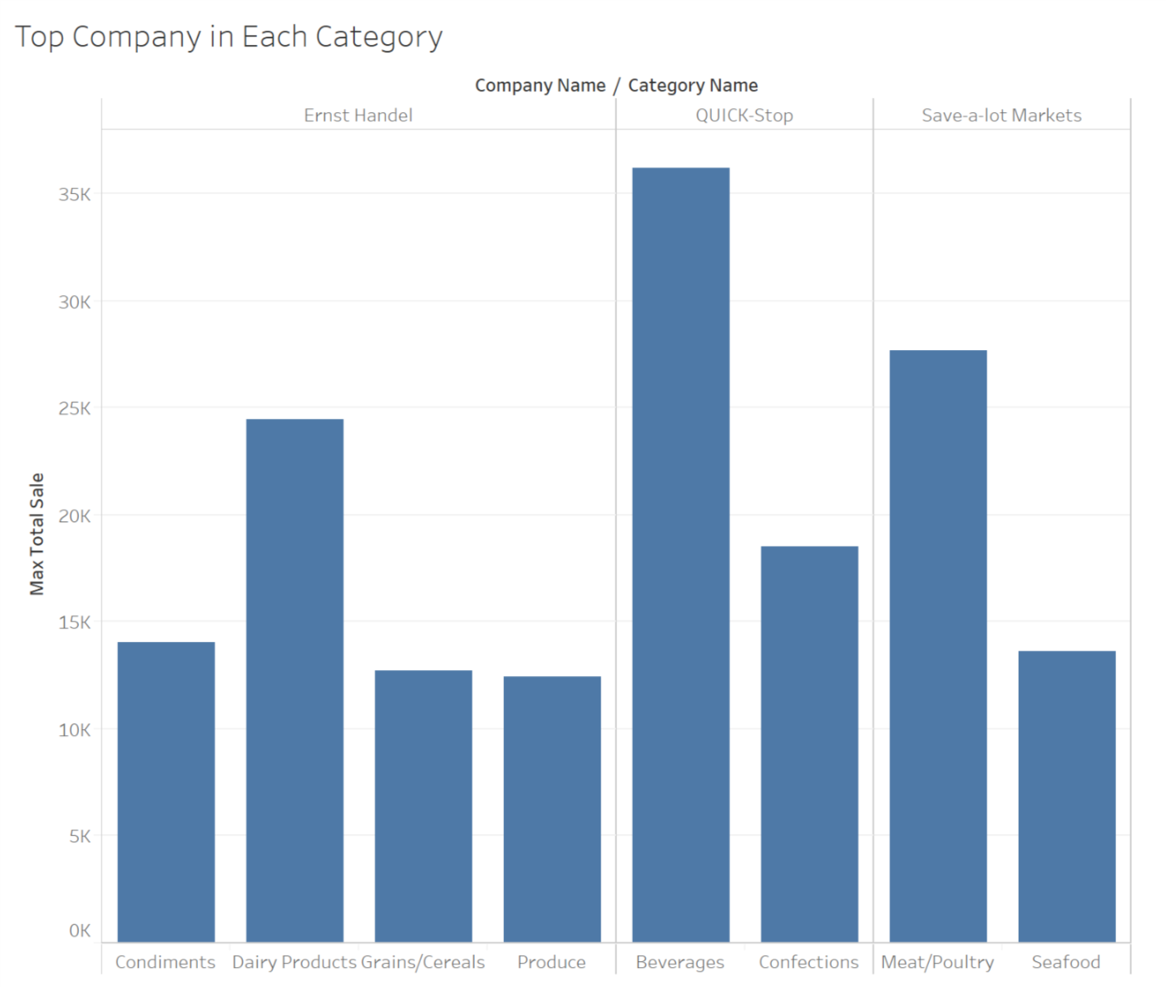
Top Company in Each Category of Products
<visualization>
The highest total sale by companies in categories of products are occupied by three companies.
It also shows the Beverages category contributes the most for the total sale.
Notes:
WITH t1 as (
SELECT o.OrderId, d.ProductID, d.UnitPrice*d.Quantity*(1-d.Discount) order_sale
FROM Orders o
JOIN Orderdetails d
ON d.OrderID = o.OrderId),
t2 as (
SELECT c.CustomerID, c.CompanyName, a.CategoryID, a.CategoryName, SUM(t1.order_sale) total_sale
FROM Customers c
JOIN Orders o
ON o.CustomerID = c.CustomerID
JOIN t1
ON t1.OrderId = o.OrderId
JOIN Products p
ON p.ProductID = t1.ProductID
JOIN Categories a
ON a.CategoryID = p.CategoryID
GROUP BY 1, 2, 3, 4),
t3 as (
SELECT CategoryID, CategoryName, MAX(total_sale) max_total_sale
FROM t2
GROUP BY 1, 2)
SELECT t2.CompanyName, t2.CategoryName, t3.max_total_sale
FROM t2
JOIN t3
ON t2.CategoryID = t3.CategoryID and t2.CategoryName = t3.CategoryName
WHERE t2.total_sale = t3.max_total_sale;

